Slide 1

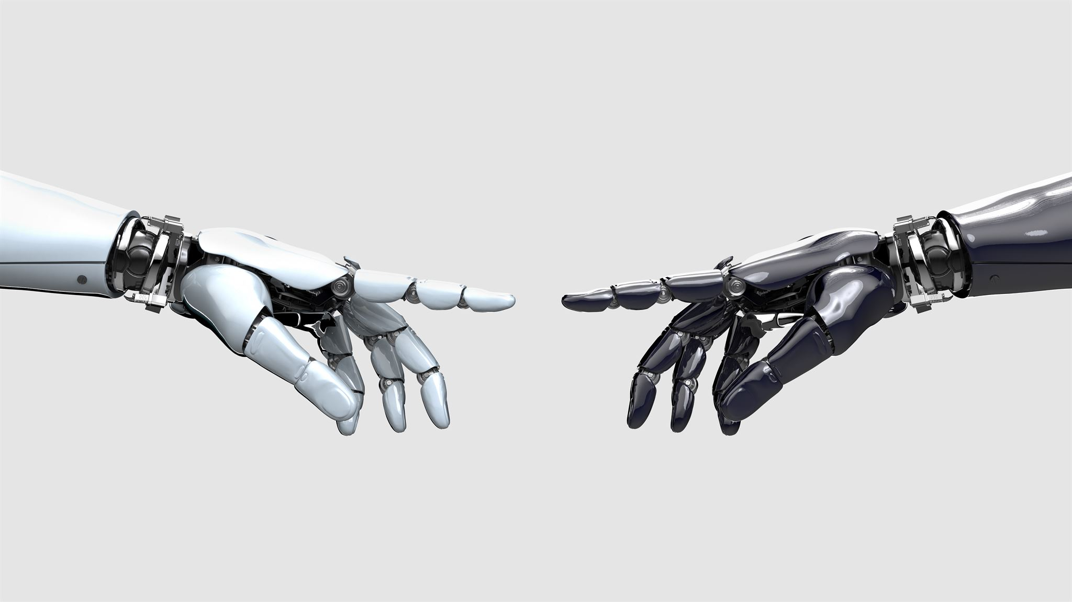
Mapping the Global AI JOB MARKET
Analyzing Trends By Industry, Employment Type, Skillsets, And Hiring Urgency

Slide 2
Agenda
01 | Introduction
02 | AI Job Market Overview
03 | Dataset Overview
04 | Trends Analysis
05 | Key Takeaways

Slide 3

Introduction

Slide 4
Data Analytics: Capstone Project
Presenter: Daniel Mapes
Professional Background: Client Experience + Data Analytics
Industry Experience: WeWork, Inspirato, KJJFI
Contact: dmapes2693@gmail.com
Notes:
I currently work at WeWork, which is a global coworking space home to companies across big tech, energy, recruiting, cybersecurity, retail, and more. Many of them are engaging with AI in different ways — and being surrounded by that every day sparked a curiosity to learn more about the AI job market.
As someone newly trained in data analytics, I saw this project as a path to explore how my skills could align with AI industry opportunities across various sectors.
I wanted to dig further into questions like:
-What roles are most in demand?
-Which industries and countries are hiring?
-What skills should I focus on next?
-And what does remote work really look like in this space — which is important to me personally as I look toward my next role.

Slide 5
AI JOB MARKET OVERVIEW

Slide 6
AI Job Market Overview
The global AI job market is projected to grow from $515B in 2023 to $2T+ by 2030.
74% increase annually in AI and machine learning positions within the last 4 years.
Bureau of Labor Statistics projects a 15% increase annually in computer and information research jobs through 2029.
New jobs are emerging (Generative AI Engineer, Machine Learning Researcher), while traditional roles are evolving (Data Scientist, Data Analyst).
Entry into this field increasingly requires elevated, technical skillsets, highlighting Python, machine learning, data analysis, and NLP.
Notes:
As artificial intelligence (AI) continues to disrupt—and, in some cases, bolster—the job market by creating new demand, the number of AI jobs has steadily increased in recent years. Recent Aura Intelligence data hows that AI-related jobs accounted for over 12.5% of all software hiring. There has been a 74% increase annually in AI and machine learning positions within the last 4 years. Additionally, the global AI job market is projected to grow from $515B in 2023 to $2T+ by 2030. (Aura)
AI's potential impact on the job market continues to be viewed as somewhat dire from many perspectives. For example, an early study by OpenAI on the labor market impact of large language models (LLMs) predicted that "around 80% of the U.S. workforce could have at least 10% of their work tasks affected by the introduction of LLMs" and that approximately "19% of workers may see at least 50% of their tasks impacted.” (Aura)
That being said, AI-driven tools will automate many repetitive tasks in sectors like accounting, transportation, and manufacturing, freeing human workers to focus on more strategic, creative roles.
New jobs are emerging (Generative AI Engineer and Machine Learning Researcher), while traditional roles are evolving (Data Scientist and Data Analyst). (Aura)
For job seekers, the key to thriving in this competitive job market lies in understanding in-demand skills and acquiring relevant qualifications. Whether it’s a bachelor’s degree in computer science or specialized AI certifications, job-ready candidates will be those who can provide real-world solutions through AI-driven tools and concepts. (Aura) These new professional opportunities prove to be quite lucrative and can be worth the investment to upskill yourself, as many of us here are doing through this bootcamp.

Slide 7
Dataset Overview + Context

Slide 8
Dataset Overview + Context
Dataset: Global AI Job Market Trends + Salary Insights 2025
Research Resources: Aura Job Market Research
Tools Used: Python, SQL, Tableau
Disclaimer: Synthetically generated by AI Language Model to simulate real world job-trends
Key Takeaway: Data needs context
Notes:
This dataset was synthetically generated by an AI language model, so while it doesn’t represent real-world data exactly, it was informative and well-structured. This dataset was perfect for building an analytical data model to further my understanding of the AI job market and the opportunities within it.
The dataset contains 15,000 job postings, defined across 20 columns. This aligned well with the Aura Intellgience articles I used as additional resources, which showed approximately 16,000 AI related jobs were posted in 2024.
To perform this analysis, I employed:
Python for exploratory data analysis, including cleaning and column creation. I also used Python for statistical analyses and to create visuals.
Where Python may have been more cumbersome, I used SQL to run queries to further my analysis.
I created multiple, interactive dashboards in Tableau.
I paired these tools with real-world research from sources like Aura and noticed strong alignment on trends like top skills and in-demand roles, but I also recognized how critical context and source transparency are in data analysis.
Two of my biggest takeaways:
1) Data quality can make or break your workflow 2) Even clean data needs contextual grounding to be useful or trustworthy. This reinforces the importance of human intelligence and participation in the AI world, as these models and tools need intuitive, insightful input to be most effective.
This experience gave me a clear path forward: in the future, I’d love to repeat this analysis using actual scraped or purchased datasets to compare performance — possibly narrowing it to a specific industry, company, and job board to conduct a more granular analysis.
From here, we will dive into various trends analyses.
______
About Aura Intelligence:
Aura Intelligence is a data-driven insights platform focused on analyzing emerging trends in the workforce, particularly around AI, tech jobs, and the future of work. They publish research reports, infographics, and articles based on large-scale job posting data and market signals.
Aura often partners with job platforms or uses advanced scraping and analytics techniques to surface trends across global hiring platforms. Their work is especially valuable for workforce planning, skills training, and identifying gaps in the labor market.
To help validate and compare my findings, I used external research from Aura Intelligence, which tracks trends in AI hiring, job titles, skills, and salary ranges across global markets. Their articles gave me helpful real-world context to evaluate how closely my synthetic dataset aligned with actual trends

Slide 9
GLOBAL TRENDS

Slide 10
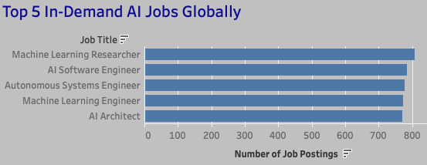
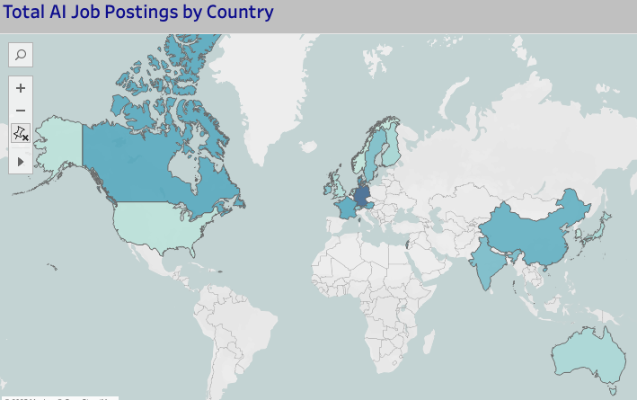
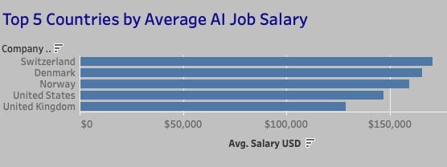
Global Trends
Most Jobs: Germany, 814
Highest Demand Job: Machine Learning Researcher, 808 openings
Highest Avg. Salary: Switzerland, $170,639
Highest Avg. Benefits Score: Denmark, 7.6
Max Continental Hiring: Europe
Notes:
This dashboard models global hiring trends in AI roles using a synthetic dataset designed to reflect real-world job board activity between January 2024 and April 2025.
At the top right, you’ll see the top 5 most in-demand roles — Machine Learning Researcher and AI Software Engineer lead the list.
On the map, countries with higher AI job volumes are shaded darker — Germany, Denmark, and Canada show the most modeled postings. (According to Aura, the US leads currently)
On the bottom right, Switzerland comes out on top for average AI salary, with a max modeled salary of over $170,000.
Denmark also had the highest benefits score, which is a metric based on perks like healthcare, vacation days, and other modeled offerings.
Overall, Europe led in total monthly job postings, suggesting strong investment in AI talent across the continent.
JOB TITLE DEFINITIONS:
Machine Learning Researcher: Designs, develops, and experiments with new machine learning algorithms and models. This role is more theoretical and innovation-focused than a traditional data scientist or machine language engineer.
AI Software Engineer: Builds and maintains software systems that integrate artificial intelligence. While Machine Learning Researchers focus on developing new models and algorithms, AI Software Engineers focus on applying those models to real-world products and services.
Autonomous Systems Engineer: Designs and develops machines or systems that can operate independently (without human control), using a mix of AI, robotics, and sensors. These engineers build the brains and control systems for things like self-driving cars, drones, robots, or industrial automation.
Machine Learning Engineer: A type of software engineer who specializes in building, training, deploying, and maintaining machine learning models that allow software systems to learn from data and make predictions or decisions without being explicitly programmed.

Slide 11
INDUSTRY TRENDS

Slide 12
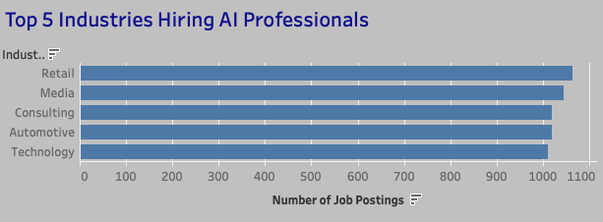
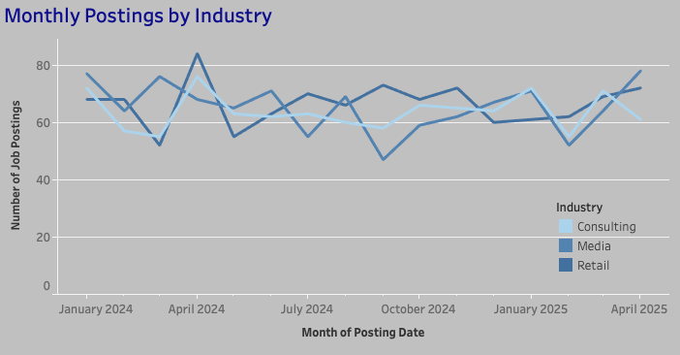
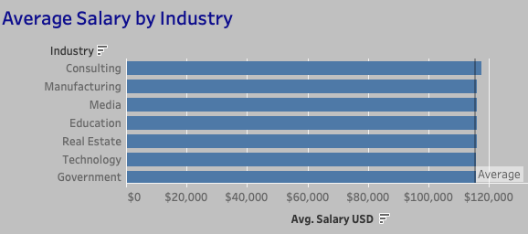
Industry Trends
Most Roles: Retail, Media, Consulting
Highest Avg. Salaries: Consulting, Manufacturing, Media
Avg. Salary across Company Size: $115,357
Seasonal Hiring Peak: Q2 2024
Seasonal Hiring Drop: Q4 2024, Q1 2025 rebound
Notes:
This dashboard breaks down job volume and salaries by industry.
The top hiring industries were Retail, Media, and Consulting — with strong representation from Automotive and Tech as well.
In terms of compensation, Consulting ($117,602) and Manufacturing ($116,163) offered the highest average salaries. These sectors likely demand more specialized technical skill sets or offer more premium project-based roles.
With regards to company size, this dataset categorized companies into Small, Medium, and Large. As one might predict, larger companies boasted higher salaries in this analysis, as larger companies tend to have more expansive budgets. Small companies trail not too far behind, still over the $100k average mark.
You’ll also notice a hiring dip in Q4 2024, which is a common seasonal trend likely tied to end-of-year budget and hiring freezes. That’s followed by a strong rebound in Q1 2025 across most industries, which suggests that annual budget resets and planning cycles fuel new hiring.
Since this dataset is AI-modeled, the patterns are not from actual job boards — but they do mirror real-world trends observed in separate labor market articles, particularly in their seasonal rhythm and sector breakdowns.
If I have time, I’ll toggle to this dashboard live to provide more information on additional top hiring industries and monthly trends.

Slide 13
EMPLOYMENT TYPE TRENDS

Slide 14
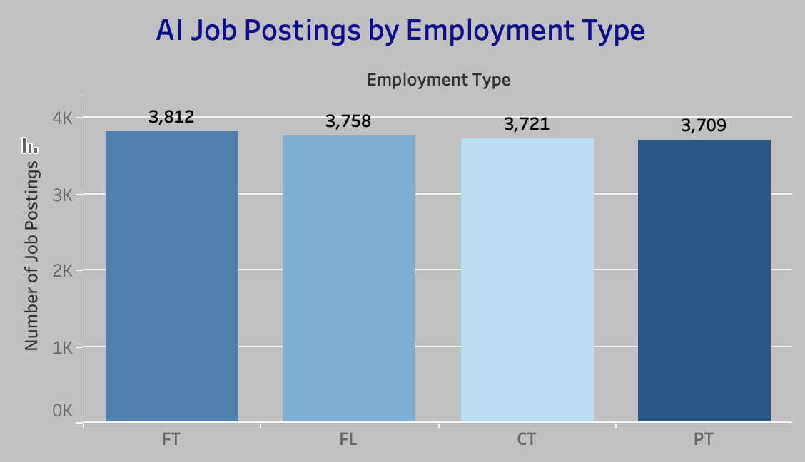
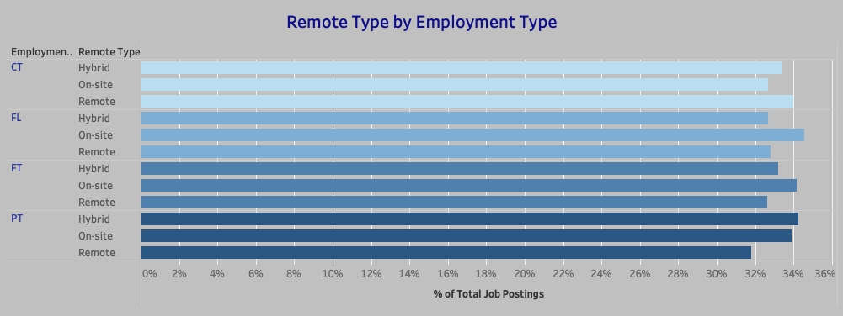
Employment Type Trends
Most Roles: Full-Time (3812), Freelance (3758)
Remote Type: Remote (32.8%), Hybrid (33.36%), On-Site (33.8%) split almost evenly
Employment x Remote: Full-Time with significant On-Site %, Contract with highest Remote %
Flexibility: Reflects remote-friendly nature of AI industry
Notes:
This dashboard breaks down AI jobs by employment type and workplace flexibility.
Full-time roles make up the majority of postings, which is expected — but freelance roles were surprisingly close behind, showing the growing acceptance of non-traditional work models in the AI space.
When looking at remote flexibility, I saw an almost perfect three-way split:
On-site: 33.8%
Hybrid: 33.36%
Remote: 32.8%
While close, this near-even distribution shows that remote capability is a core expectation in AI hiring — likely because it allows companies to source top talent regardless of location.
Some noteworthy findings:
That said, freelance roles are the most likely to require on-site presence, which might be due to confidentiality, project complexity, or company-specific policies.
Contract roles were evenly split across remote types, while part-time roles leaned more toward hybrid setups, suggesting flexibility matters for both employers and employees in those categories.
This reflects how the AI industry supports a highly adaptable workforce, often prioritizing talent and specialization over physical location — a promising trend for those pursuing remote-friendly roles in the space.

Slide 15
REQUIRED SKILLSET TRENDS

Slide 16
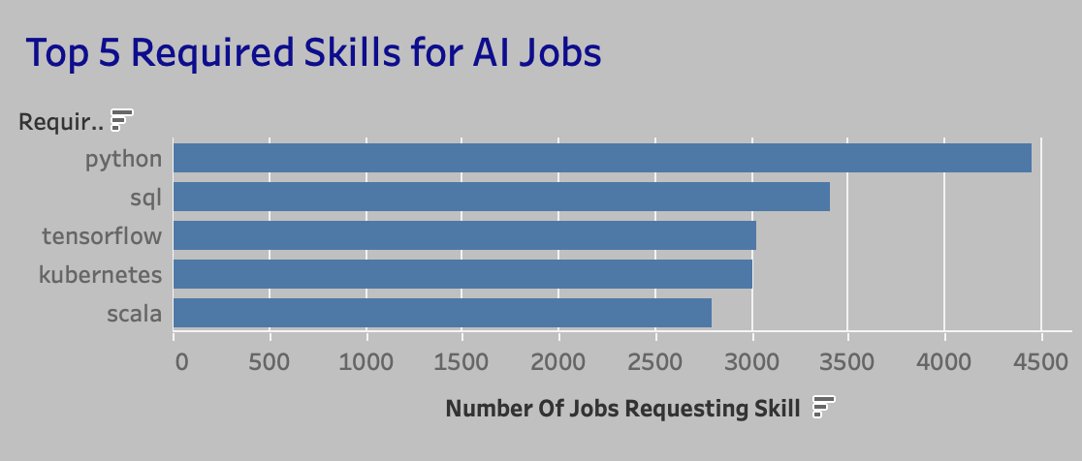
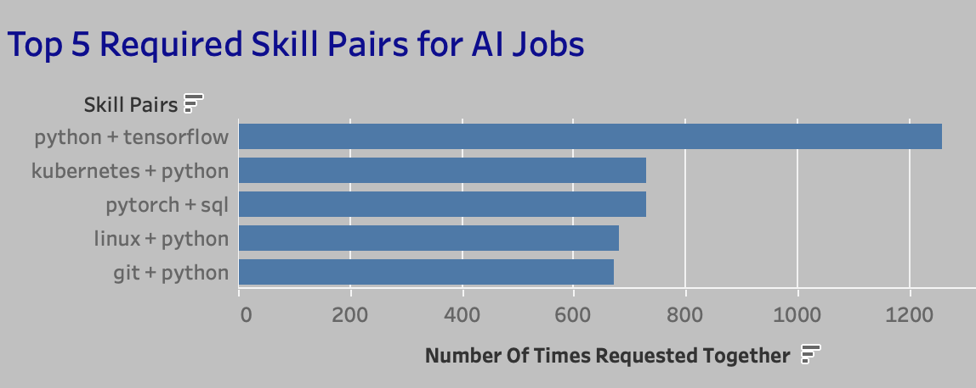
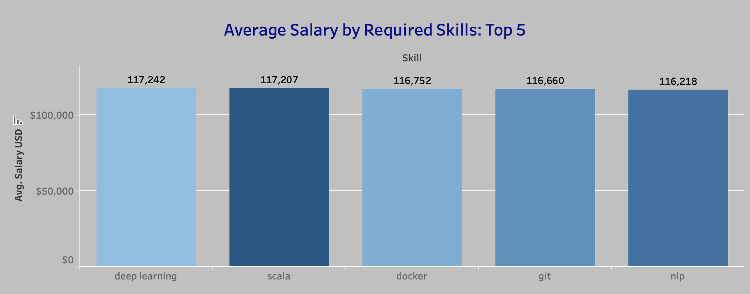
Required Skillset Trends
Most Requested: Python, SQL, Tensorflow
Top Skill Combos: Python + Tensorflow, Python + Kubernetes
Top Avg. Salary by Skill: Deep Learning, $117,242
Skill Diversity: Shows wide demand across tools; clear direction for upskilling in AI roles
Notes:
What skills are actually in demand for AI jobs right now, based on the model?
Python is by far the most requested skill — it appeared in 4,450 of the 15,000+ job postings. This wasn’t a surprise, since Python is widely used in both machine learning and data analysis.
Next came SQL, and then TensorFlow, which is a key library for building and training AI models.
When looking at skill combinations from job descriptions, the most common pair was Python + TensorFlow, which makes sense given the tight integration of the two. Another strong pair was Python + Kubernetes. Python is the go-to-language for building machine learning models, while Kubernetes is used to deploy those models in production.
The skill with the highest average salary was Deep Learning, at about $117,000. That tells us that not only is it in demand, but it also commands premium compensation — likely due to its more advanced nature and application in areas like computer vision, NLP, and generative AI.
These charts give a clear direction for upskilling — Python is a non-negotiable foundation, but adding tools like TensorFlow, PyTorch, or Deep Learning frameworks can significantly increase both your marketability and earning potential.
_____________
Definitions, for context:
Natural Language Processing is a subfield of artificial intelligence focused on how computers can understand, interpret, and generate human language.
In practical terms, it powers tools like chatbots, language translation apps, speech-to-text features, and large language models like ChatGPT.
Neural Networks are a key technology behind modern artificial intelligence. They’re modeled after the structure of the human brain and are designed to recognize patterns in data.
A neural network consists of layers of interconnected “neurons” that pass information between each other — learning from data over time to make predictions or decisions.
Deep Learning is a type of machine learning that uses artificial neural networks to learn from data. Artificial neural networks are inspired by the human brain, and they can be used to solve a wide variety of problems, including image recognition, natural language processing, and speech recognition.
Tensorflow is an open-source software library developed by Google for machine learning and artificial intelligence. It’s primarily used for building and deploying machine learning models, especially deep learning models.
Kubernetes automates operational tasks of container management and includes built-in commands for deploying applications, such as rolling our changes, scaling up and down to fit changing needs, and monitoring.
Pytorch is an open source machine learning framework based on the Python programming language and the Torch library. It is widely used for building and training deep neural networks, particularly in areas like computer vision and natural language processing.

Slide 17
EXPERIENCE + EDUCATION TRENDS

Slide 18
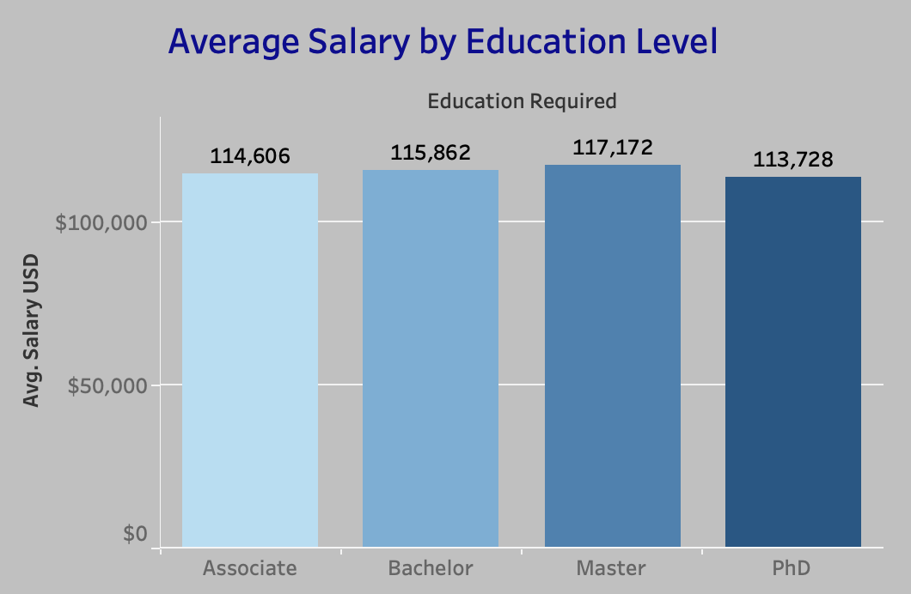
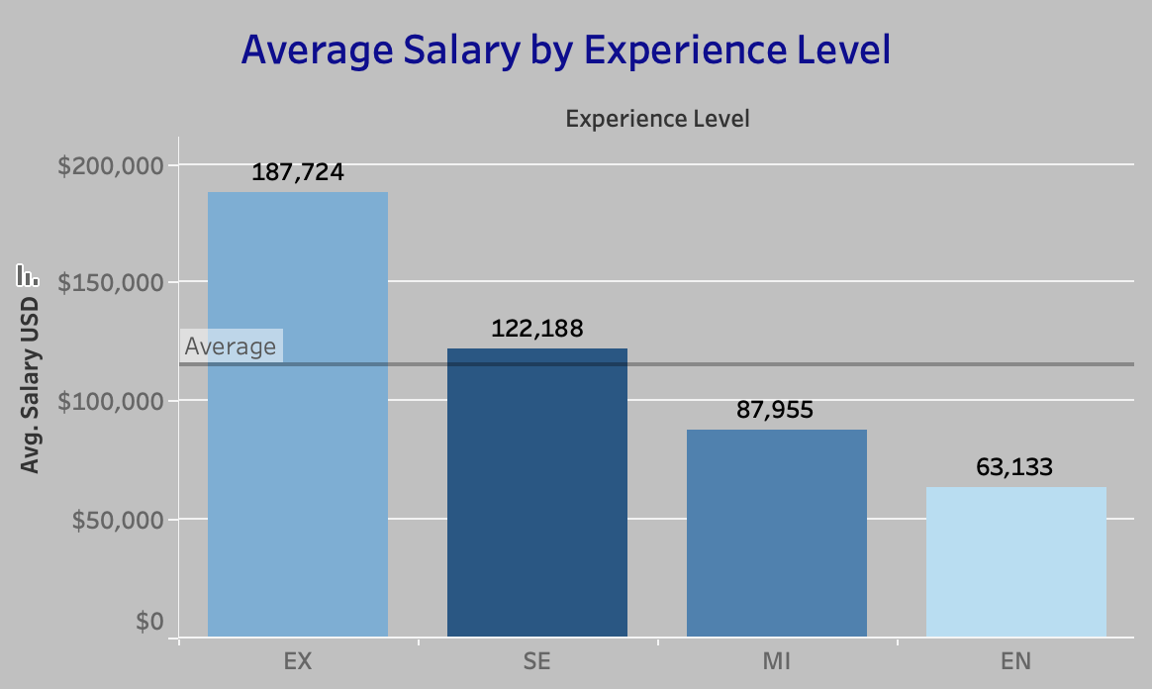
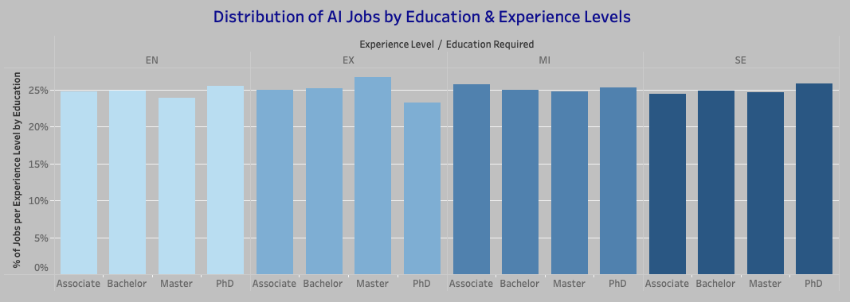
Experience + Education Trends
Most Requested Experience Level: Mid-Level (3-5yr), 3781 jobs
Highest Avg. Salary by Experience: Executive, $187,724
Highest Avg. Salary by Education: Master’s, $117,172
Avg. Entry Level Role Salaries are competitive, $63,133
Outlier: 971 “Entry-Level” roles require PhD
Notes:
Across the dataset, Master’s degrees were associated with the highest average salary — around $117,000. But surprisingly, Associate’s degrees came in just behind at $114K. This may be inflated due to a small sample size for Associate-level roles or synthetic weighting in the dataset. Still, it suggests that not all high-paying roles require graduate-level education.
That said, Executive Level and Senior Level roles had the highest average salaries, which makes sense as they require more responsibility and specialization. What stood out the most to me is how competitive entry-level salaries are (around $63k)—making this an encouraging time for early-career professionals to step into the AI industry.
In terms of experience, the Mid-Level experience range (3–5 year) was most frequently requested, suggesting that mid-level professionals are in high demand.
EDIT: On the flip side, there were 971 roles labeled "entry-level" that also required a PhD, which is a likely inconsistency from the AI-generated dataset. Other reasons this could be: these roles could be low-paying internships or fellowships for PhD candidates; direct from academia to industry roles without much professional experience; overinflated requirements on these ”job boards”; or a result of specialization in niche fields. This gave me a valuable reminder: data needs logical context, and it’s our job to question the quality and interpret with care.
So overall, while formal education and seniority can boost earnings, there’s clearly space in this industry for early-career professionals, especially those who build relevant skills like Python, SQL, and ML frameworks.

Slide 19
HIRING URGENCY TRENDS

Slide 20
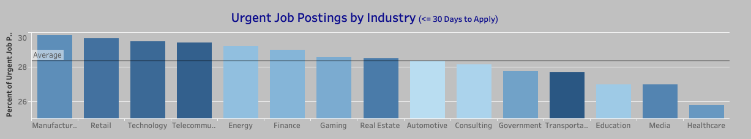
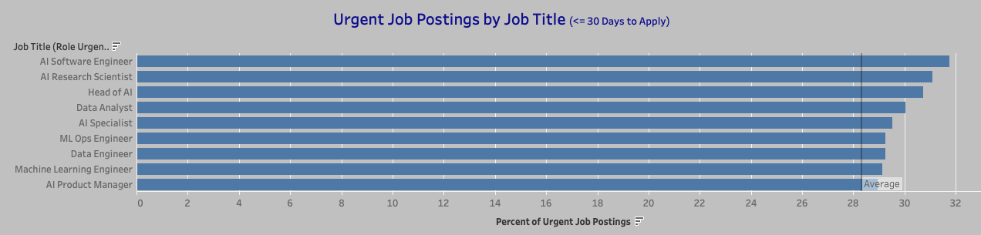
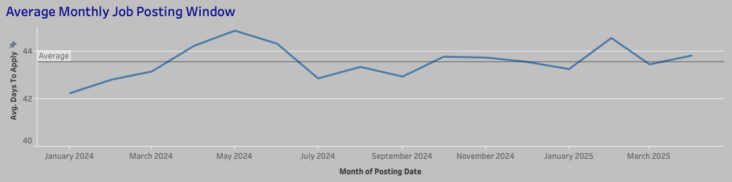
Hiring Urgency Trends
Avg. Days to Apply: 43.5 days
Most Urgent Industries: Manufacturing, Retail, Tech
Most Urgent Roles: AI Software Engineer, AI Research Scientist, Head of AI, Data Analyst
Monthly Hiring Urgency varies; likely tied to new project cycles + budget activations
Notes:
In this section, I explored hiring urgency by calculating the number of days between a job’s posting date and its application deadline. On average, AI job postings remained open for about 43.5 days — that's our baseline for urgency.
When broken down by industry, the most urgent hiring occurred in Manufacturing, Retail, and Tech. These industries may have shorter planning or production cycles, or immediate needs to scale up AI efforts, prompting faster recruiting.
The job titles with the highest hiring urgency were:
AI Software Engineer
AI Research Scientist
Head of AI
Data Analyst
I was especially excited to see Data Analyst on this list — this emphasizes that organizations urgently need people who can clean, interpret, and visualize data to drive AI initiatives. That’s directly relevant to this cohort.
The monthly urgency chart tracks how long postings were open over time. A lower value on the line indicates more urgency — meaning jobs had shorter application windows that month.
Based on the data, the most urgent hiring periods occurred during:
January–March 2024
July–September 2024
January 2025
These cycles may reflect new year planning phases, mid-year pivots, or seasonal tech deployments. While this is a synthetic dataset, these modeled insights align with hiring surges you’d expect around Q1 budgets and Q3 project ramp-ups.
This reinforces the importance of timing in job searches, which may be particularly relevant to our cohort in the coming months.

Slide 21
KEY TAKEAWAYS

Slide 22
Key Takeaways
Global hiring is growing exponentially—especially in Europe
AI is elevating traditional roles and creating entirely new ones across multiple industries
Remote and hybrid work is widely supported
Python, TensorFlow, + SQL remain top skills
Salaries and benefits scores are competitive, even at entry level
Hiring urgency will likely increase as AI implementation expands across sectors
Data needs context, but strong models can be built with AI + human insight

